Slide 1
Case study 1
Eli Kravez & Katherine Lockard

Slide 2
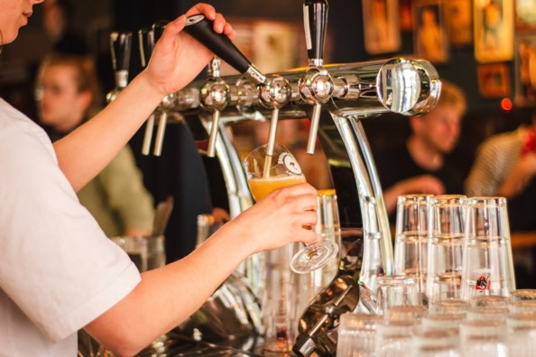
Introduction
Problem:
Analyzing the beers and breweries in the US
Data sets contain 2410 different beers and 558 breweries in the 50 states
We will analyze alcohol content and bitterness for the beers

Slide 3
Breweries by State
CO: 47 breweries
DC, ND, SD, WV: 1 brewery
Notes:
Q1 Breweries by state – we see Colorado has the maximum with 47 breweries and DC, North Dakota, South Dakota, and West Viriginia have the least with only 1 brewery

Slide 4
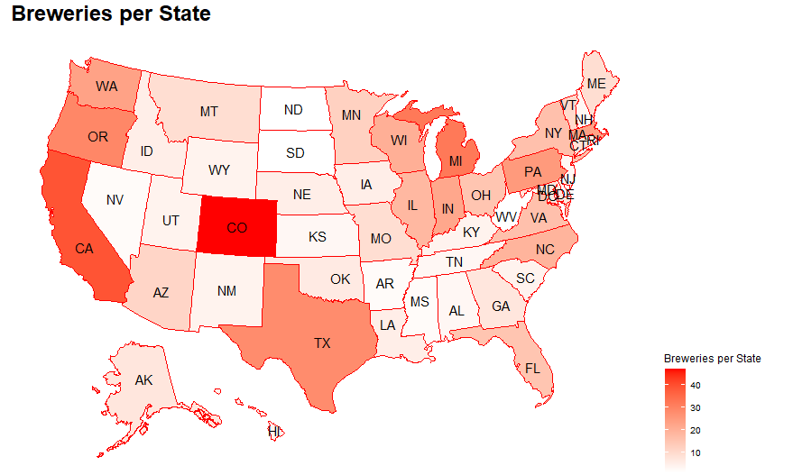
Breweries by State
Top 3 States:
Colorado
California
Michigan
These states hold 21% of the nation’s breweries
Notes:
Q1 - Top 3 breweries hold 21% of the nation’s breweries.

Slide 5
Visualizing the Missing Data
Percent Missing Data:
IBU: 41.7%
ABV: 2.57%
Style: .21%
Replaced missing values using the medians of each style
Notes:
Q3 Missing Data – IBUs have the most missing data at 41.7% of the data set.
ABV – 2.57%. Style .21%

Slide 6
Replacing the Missing Data
IBUs: 2.16% still missing
Most of these are ciders
Replaced remaining values with the global median
Notes:
Q3 Missing Data – IBUs have the most missing data at 41.7% of the data set.
ABV – 2.57%. Style .21%

Slide 7
Median ABV by State
Range: 4.0% - 6.5%
Mean: 5.0%
Notes:
Q4

Slide 8
Median IBU by State
DE and WV Outliers
Range: 17.75 – 60.5
Mean: 33.11
Delaware & West Virginia are outliers
Only two beers from each state

Slide 9
Comparison of State Median IBU and ABV
There seems to be positive correlation between median ABV and IBU.
Pearson correlation = 0.28

Slide 10
Maximum ABV
Colorado
Lee Hill Series Vol. 5 - Belgian Style Quadrupel Ale from Upslope Brewing Co.
ABV: 12.8%
IBU: 24
Style: Quadrupel (Quad)

Slide 11
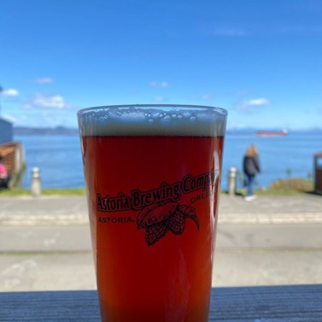
Maximum IBU
Oregon
Bitter Bitch Imperial IPA from Astoria Brewing Company
IBU: 138
ABV: 8.2%
Style: American Double / Imperial IPA

Slide 12
Distribution of ABV
Summary Statistics of Percent ABV:
Min: 1.0%
Q1: 5.0%
Median: 5.6%
Mean: 5.972%
Q3: 6.7%
Max: 12.8%
Mean > Median
Right-skewed distribution

Slide 13
Distribution of ABV
Only 2 beers from Delaware
Many outliers in Michigan
Only 2 beers from West Virginia

Slide 14
Relationship between IBU and ABV
Positive correlation between ABV and IBU
Lee Hill Series Vol. 5
Notes:
Example of outlier: Maximum ABV beer is only 24 IBU
Q7

Slide 15
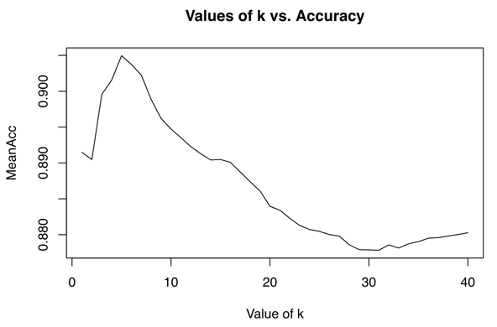
kNN Classification
Built kNN classification model using
K = 5
Mean accuracy = .905
This classification model will look at the 5 nearest neighbors and classify the unknown using majority rule
Also tested a naïve-bayes model, but kNN using k – 5 was more accurate

Slide 16
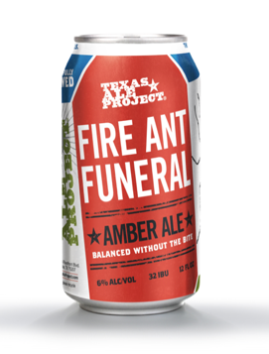
kNN Classification
Using k = 5
Specificity: 0.8767
Sensitivity: 0.8580
Test Data:
512 IPA: 65 IBU and 7.2% ABV
Fire Ant Funeral Amber Ale: 32 IBU and 6.6% ABV
Model classified each correctly, with 100% probability

Slide 17
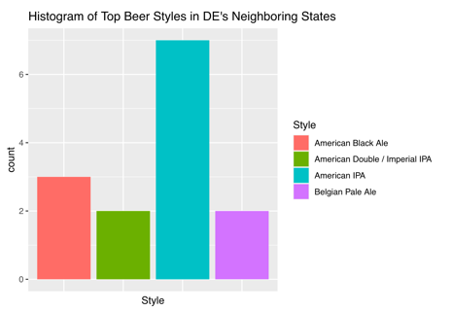
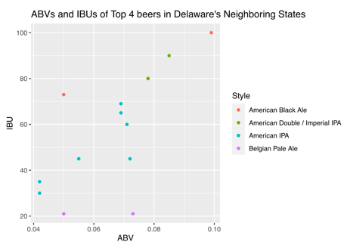
New Product Recommendations for DE
There are only two beers from Delaware
Looked at most popular beers in neighbor states
New Jersey
Maryland
Based upon neighbors, beers that could be successful in Delaware are:
American IPA:
50-60 IBU
7% ABV
Imperial IPA
80-90 IBU
8% ABV
Belgian Pale Ale
20 IBU
7% ABV

Slide 18
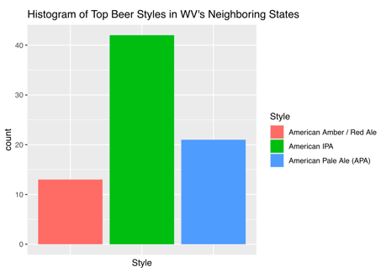
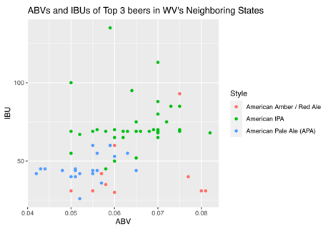
New Product Recommendations for WV
There are also only two beers from West Virginia
Looked at most popular beers in neighbor states
Pennsylvania
Virginia
Kentucky
Ohio
Based upon neighbor states, beers that could be successful in West Virginia are:
American IPA
70 IBU
ABV of 6-7%
American Pale Ale (APA)
45 IBU
5-6% ABV

Slide 19
Image Links
https://www.brewbound.com/news/upslope-brewing-releases-vol-5-of-lee-hill-series/
https://cdn.shopify.com/s/files/1/0548/5481/products/0003_astoria_2ipa_0453c602-0e68-438b-bf04-d8b1cf314d19.jpeg?v=1405915880
https://untappd.akamaized.net/photos/2021_04_11/1201ae34f779dcca160fc2db79709347_640x640.jpg
https://d1i7h2skkdect3.cloudfront.net/wp-content/uploads/2020/07/louis-hansel-shotsoflouis-WCm4dFvZnMM-unsplash-scaled-1170x780.jpg
Notes:
Example of outlier: Maximum ABV beer is only 24 IBU

